Slide 1




Slide 2
Examples of Transformers Applications

Slide 3


Raw Text
Predictions
Pipeline module
API Layer
Transformers Library

Slide 4
Pipeline Module
Raw Text
Tokeniz-ation
Input IDs
Model
Logits
Post Processing
Predictions
[101,2023,2607,2003,6429,99,102]
POSITIVE : 99.89
NEGATIVE : 0.11
This course is amazing
[-4.3630,4.6869]

Slide 5
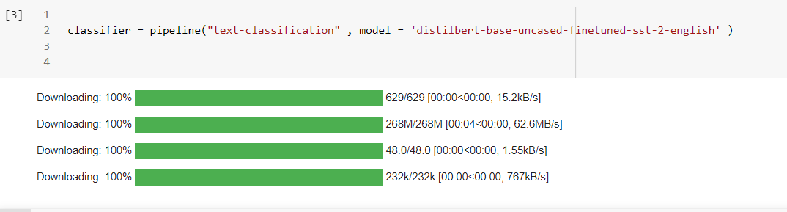
EX1: Text Classification
Install the Transformers Library
Instantiating Pipeline:
from transformers import pipeline
classifier = pipeline (
Pipeline automatically downloads the model weights from the Hugging Face Hub.
! pip install transformers
‘task name’ ,
model= ’the pretrained model’)

Slide 6
Choose a model for your task

Slide 7
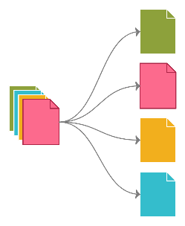
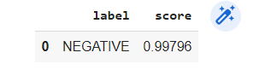
EX1: Text Classification
Classify product review from amazon.
text = """When this air fryer works it is great but upon delivery the first day it unfortunately broke. I selected the return and replace option thinking that when the item was collected, I would have a new one delivered. This was sadly not the case and the day for collection came and went with no update orexplanation as to why the collection was not completed. I contacted Amazon and after going through a few circles trying to actually speak to someone I was informed that the driver couldn't find me. This I can understand but not them not trying to contact me to help them locate my property. Finally, after three weeks of collection and delivery pending on my item the same item was returnedto me "repaired". This was not the option that I selected as if something is faulty, I do not want it back, I want a new non faulty item sent to me. The airfryer worked well for a few days then the light went out and then it stoppedworking altogether.I am now in the pending stage again but this time for a full refund.The reason I sent it back in the beginning was to avoid it breaking again as I knew it would but here we are anyway.I just hope I am not waiting an age for the refund to come through so I can purchase an airfryer elsewhere with a better level of customer service than Amazon Egypt provide """
from transformers import pipeline
import pandas as pd
classifier = pipeline (
"text-classification” ,
model='distilbert-base-uncased-finetuned-sst-2-english’ )
outputs = classifier(text)
pd.Dataframe(outputs)

Slide 8
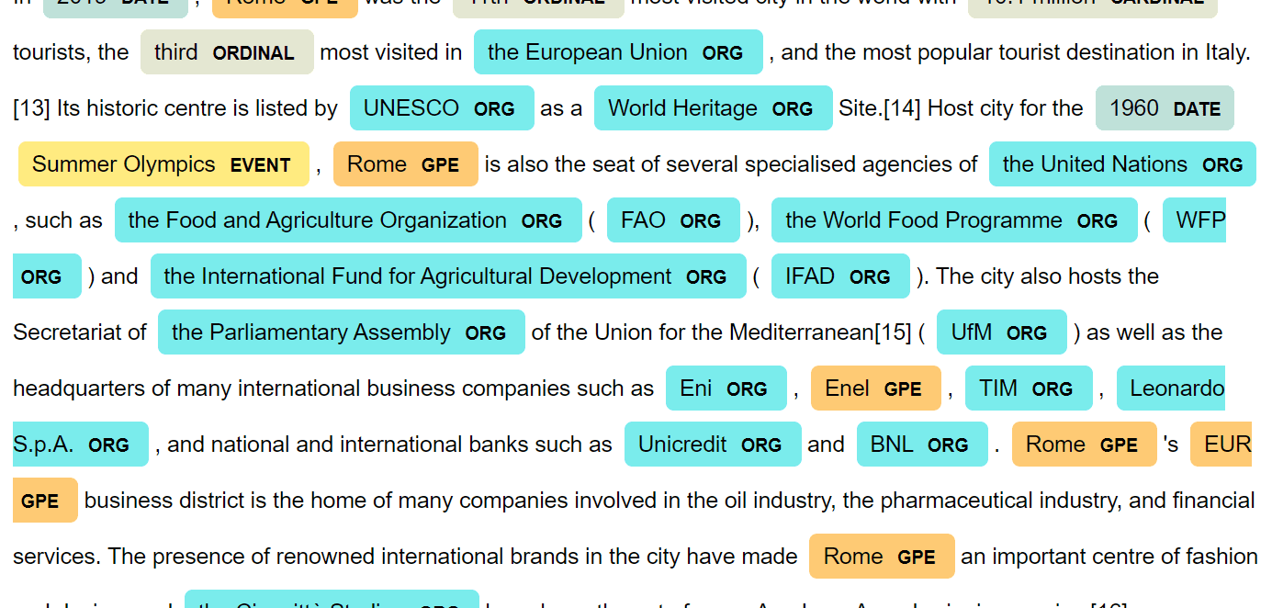

EX2: Named Entity Recognition(NER)
Named Entity Recognition (NER) is used to extract named entities from text, such as products, places, and people.

Slide 9
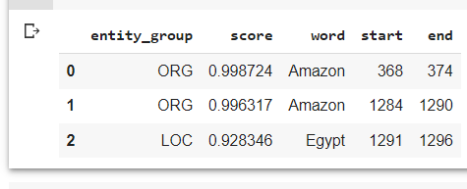
EX2: Named Entity Recognition(NER)
from transformers import pipeline
import pandas as pd
ner_tagger = pipeline(
outputs = ner_tagger(text)
out = pd.DataFrame(outputs)
out.head(3)
“ner”,
model = "dbmdz/bert-large-cased-finetuned-conll03 english“,
aggregation_strategy="simple“)

Slide 10
EX2: Named Entity Recognition(NER)
from transformers import pipeline
import pandas as pd
ner_tagger = pipeline(
outputs = ner_tagger(text)
out = pd.DataFrame(outputs)
out.head(3)
“ner”,
model = "dbmdz/bert-large-cased-finetuned-conll03 english“,
aggregation_strategy="simple“)

Slide 11
EX2: Named Entity Recognition(NER)
from transformers import pipeline
import pandas as pd
ner_tagger = pipeline(
outputs = ner_tagger(text)
out = pd.DataFrame(outputs)
out.head(3)
“ner”,
model = "dbmdz/bert-large-cased-finetuned-conll03 english“,
aggregation_strategy="simple“)

Slide 12
EX2: Named Entity Recognition(NER)
from transformers import pipeline
import pandas as pd
ner_tagger = pipeline(
outputs = ner_tagger(text)
out = pd.DataFrame(outputs)
out.head(3)
“ner”,
model = "dbmdz/bert-large-cased-finetuned-conll03 english“,
aggregation_strategy="simple“)

Slide 13
EX2: Named Entity Recognition(NER)
from transformers import pipeline
import pandas as pd
ner_tagger = pipeline(
outputs = ner_tagger(text)
out = pd.DataFrame(outputs)
out.head(3)
“ner”,
model = "dbmdz/bert-large-cased-finetuned-conll03 english“,
aggregation_strategy="simple“)

Slide 14
EX3: Question Answering

Slide 15
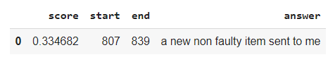
EX3: Question Answering
from transformers import pipeline
import pandas as pd
reader = pipeline("question-answering" , model = "distilbert-base-cased-distilled-squad" )
text = """When this air fryer works it is great but upon delivery the first day it unfortunately broke.I selected the return and replace option thinking that when the item was collected I would have a new one delivered. This was sadly not the case and the day for collection came and went with no update orexplanation as to why the collection was not completed. I contacted Amazon and after going through a few circles trying to actually speak to someone I was informed that the driver couldn't find me.This I can understand but not them not trying to contact me to help them locate my property. Finally after three weeks of collection and delivery pending on my item the same item was returnedto me "repaired". This was not the option that I selected as if something is faulty I do not want it back, I want a new non faulty item sent to me. The airfryer worked well for a few days then the light went out and then it stoppedworking altogether.I am now in the pending stage again but this time for a full refund.The reason I sent it back in the beginning was to avoid it breaking again as I knew it would but here we are anyway.I just hope I am not waiting an age for the refund to come through so I can purchase an airfryer elsewhere with a better level of customer service than Amazon Egypt provide """
outputs = reader(question=question , context=text )
question = "What does the customer want?"
pd.DataFrame([outputs])

Slide 16
EX3: Question Answering
from transformers import pipeline
import pandas as pd
reader = pipeline("question-answering" , model = "distilbert-base-cased-distilled-squad" )
text = """When this air fryer works it is great but upon delivery the first day it unfortunately broke.I selected the return and replace option thinking that when the item was collected I would have a new one delivered. This was sadly not the case and the day for collection came and went with no update orexplanation as to why the collection was not completed. I contacted Amazon and after going through a few circles trying to actually speak to someone I was informed that the driver couldn't find me.This I can understand but not them not trying to contact me to help them locate my property. Finally after three weeks of collection and delivery pending on my item the same item was returnedto me "repaired". This was not the option that I selected as if something is faulty I do not want it back, I want a new non faulty item sent to me. The airfryer worked well for a few days then the light went out and then it stoppedworking altogether.I am now in the pending stage again but this time for a full refund.The reason I sent it back in the beginning was to avoid it breaking again as I knew it would but here we are anyway.I just hope I am not waiting an age for the refund to come through so I can purchase an airfryer elsewhere with a better level of customer service than Amazon Egypt provide """
outputs = reader(question=question , context=text )
question = "What does the customer want?"
pd.DataFrame([outputs])
Extractive question answering: the answer is extracted directly from the text.

Slide 17


Slide 18
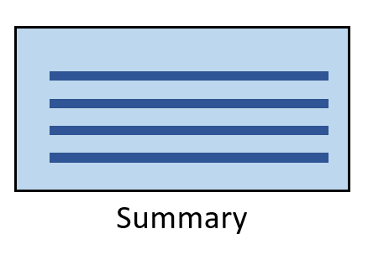
EX4: Summarization

Slide 19
EX4: Summarization
text = """When this air fryer works it is great but upon delivery the first day it unfortunately broke.I selected the return and replace option thinking that when the item was collected I would have a new one delivered. This was sadly not the case and the day for collection came and went with no update orexplanation as to why the collection was not completed. I contacted Amazon and after going through a few circles trying to actually speak to someone I was informed that the driver couldn't find me.This I can understand but not them not trying to contact me to help them locate my property. Finally after three weeks of collection and delivery pending on my item the same item was returnedto me "repaired". This was not the option that I selected as if something is faulty I do not want it back, I want a new non faulty item sent to me. The airfryer worked well for a few days then the light went out and then it stoppedworking altogether.I am now in the pending stage again but this time for a full refund.The reason I sent it back in the beginning was to avoid it breaking again as I knew it would but here we are anyway.I just hope I am not waiting an age for the refund to come through so I can purchase an airfryer elsewhere with a better level of customer service than Amazon Egypt provide """
outputs = summarizer(text, max_length=75, clean_up_tokenization_spaces=True)
print(outputs [0]['summary_text’ ])
When this air fryer works it is great but upon delivery the first day it unfortunately broke. I selected the return and replace option thinking that when the item was collected, I would have a new one delivered. The day for collection came and went with no update or explanation as to why the collection was not completed. The air fryer worked well for a few.
summarizer = pipeline ( "summarization”,model = "Schleifer/distilbart-cnn-12-6“ )

Slide 20


Slide 21


EX5: Translation

Slide 22
EX5: Translation
text = """When this air fryer works it is great but upon delivery the first day it unfortunately broke. I selected the return and replaced option. I thougth that when the item was collected I would have a new one delivered, but until now there is no update or explanation why the collection was not completed."""
translator = pipeline("translation_en_to_ar" ,model="marefa-nlp/marefa-mt-en-ar“)
outputs = translator(text, clean_up_tokenization_spaces=True, min_length= 65)
print(outputs[0]['translation_text' ])
وعندما تعمل هذه المقلية الهوائية فإنها عظيمة ولكن عند التسليم في اليوم الأول الذي تكسرت فيه لسوءالحظ.اخترت خيار العائد واستبداله كنت أويگث أنه عند جمع الصنف سيكون لدي صنف جديد تم تسليمه،ولكن حتى الآن لا يوجد تحديث أو تفسير لماذا لم يتم الانتهاء من المجموع

Slide 23
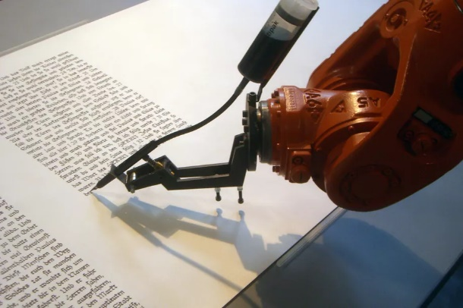
EX6: Text generation

Slide 24


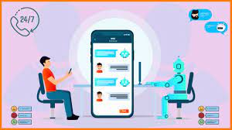
EX6: Text generation
generator = pipeline('text-generation', model='gpt2-medium')
prompt = "Dear Mohammed, we are sorry to hear that your air fryer was broken "
outputs = generator(prompt, max_length=50)
print(outputs[0] ['generated_text' ])
“Dear Mohammed, we are sorry to hear that your item has a problem !!From the time it was received, in an ideal situation, the product would have been perfect. We have taken your request seriously and are actively working on it as “

